Slide 1
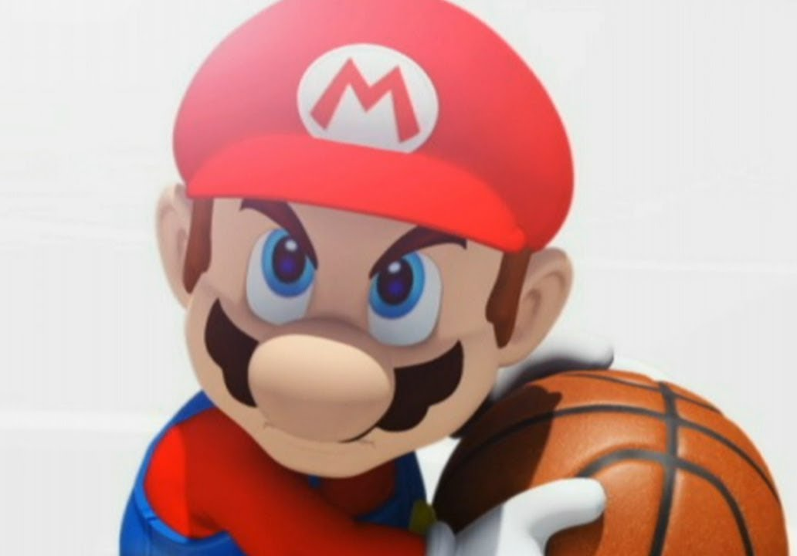

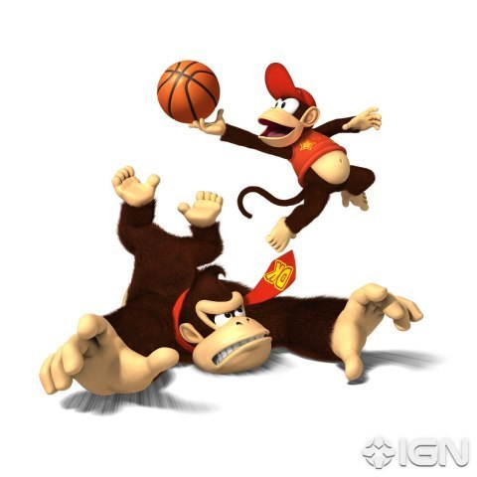
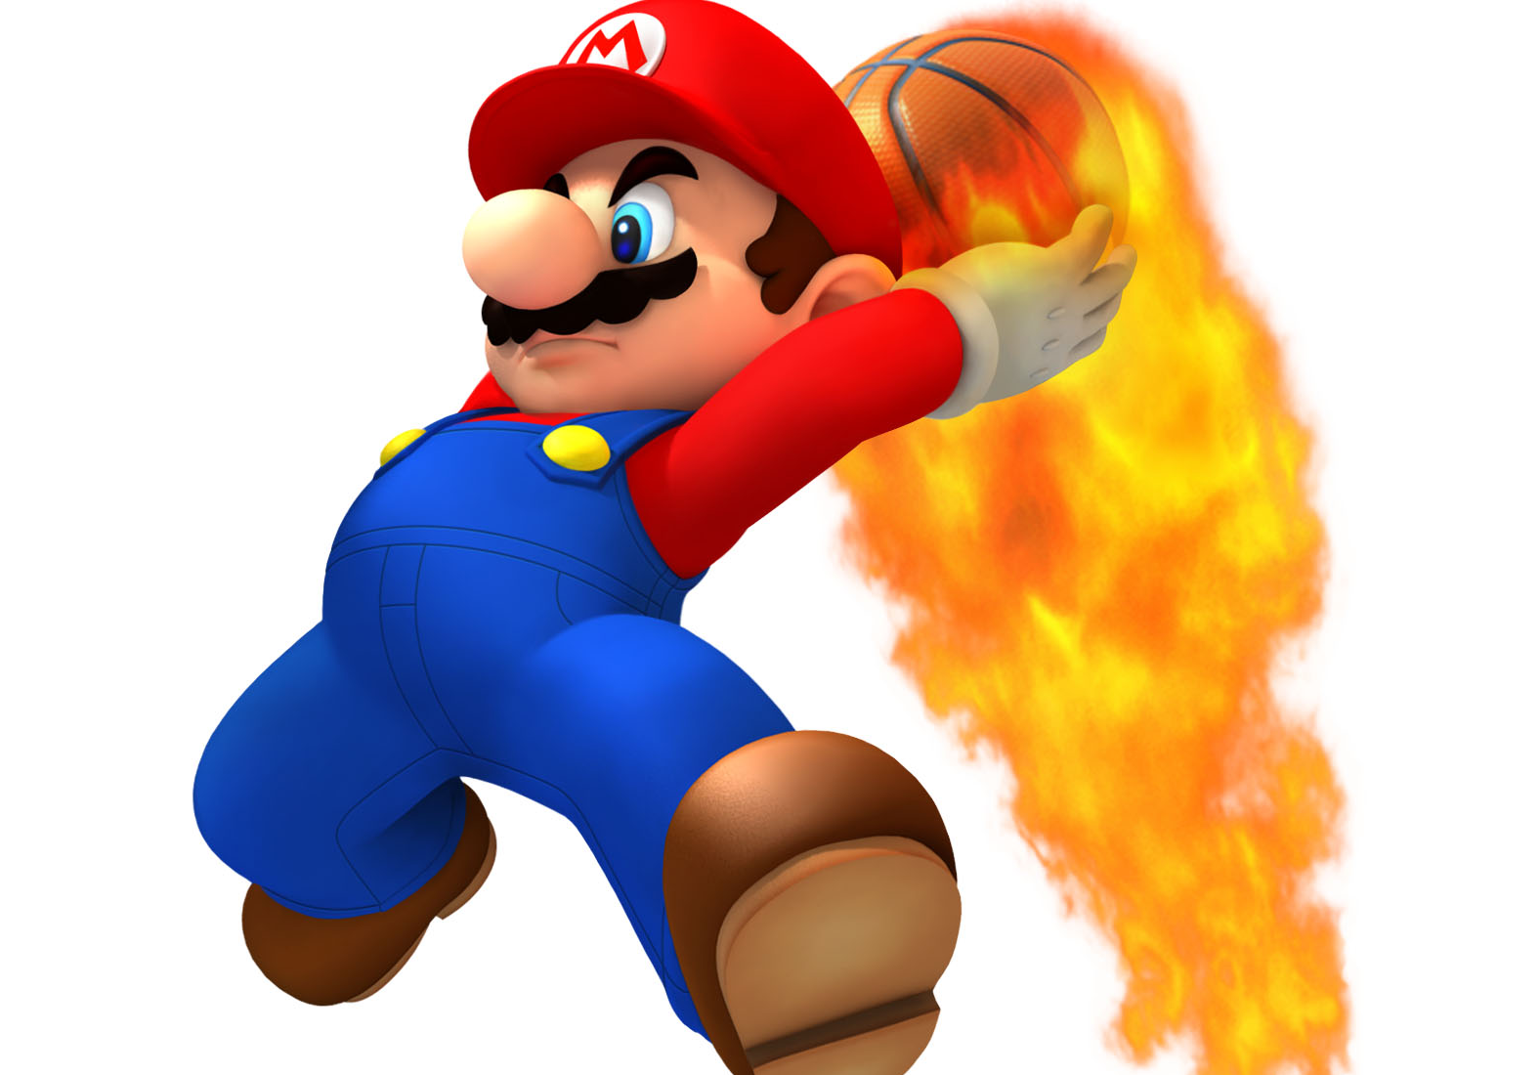
Basketball V
Produced by Dr. Mario
UNC STOR 538

Slide 2
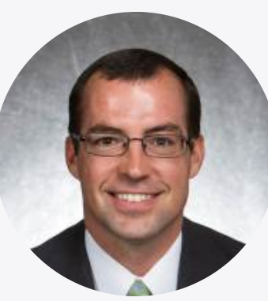
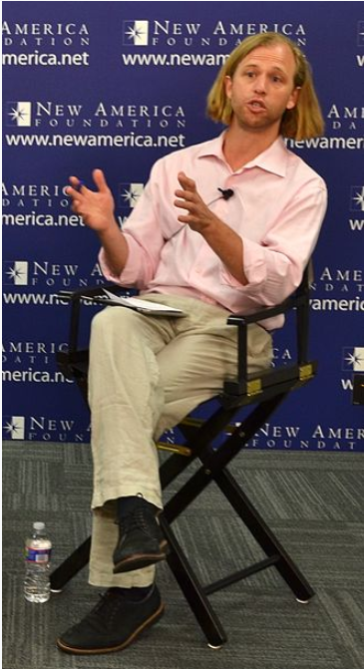
Racial Prejudice of NBA Officials
Article: Racial Discrimination Among NBA Referees
Author 1: Joseph Price from Cornell (PhD)
Author 2: Justin Wolfers from UPenn (Professor)
Claim: More Personal Fouls for Players Officiated by a Refereeing Crew of Different Race
Breakdown of Refereeing Crew
Three Officials and Four Classifications
Black Official on Black Player
White Official on White Player
White Official on Black Player
Black Official on White Player

Slide 3
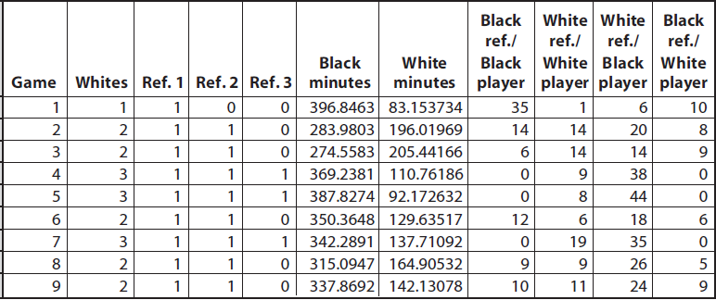
Racial Prejudice of NBA Officials
Dataset for Referee Bias

Slide 4

Racial Prejudice of NBA Officials
Fouls Per 48 Minutes
Summary Table
Estimation:
9,024 Fouls Called by Black Officials Against Black Players
310,413 Minutes for Black Players When Black Official on Court
 | White Player | Black Player
White Referee | 1.665 | 1.454
Black Referee | 1.708 | 1.423
$$Fouls Per 48 Minutes=\frac{9,024}{310,413}×48=1.423$$

Slide 5
Racial Prejudice of NBA Officials
Regression Approach of Price and Wolfer
Data Gathered
Fouls Per 48 Minutes (F)
Race of Player (R)
Percentage of Game Officials Who are White (W)
Model to Predict Fouls Per 48 Minutes
All Parameters are Statistically Significant
Possible Values for R: White=0 & Black=1
Possible Values for W: 0, 1/3, 2/3, 3/3
$$E\left[F\right]=5.1−0.763×R−0.204×W+0.182×R×W$$
Interaction

Slide 6
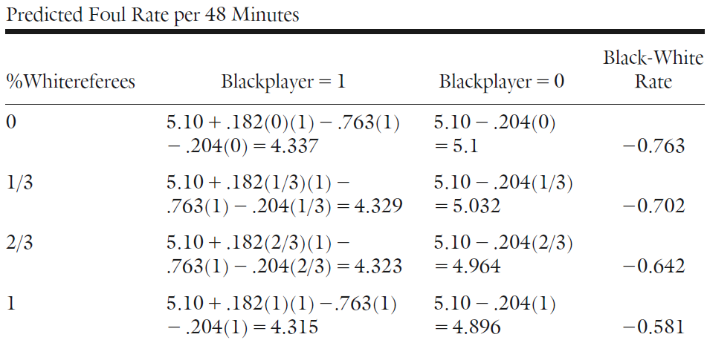
Racial Prejudice of NBA Officials
Regression Approach of Price and Wolfer
Table Showing Predicted Rates for All Scenarios

Slide 7
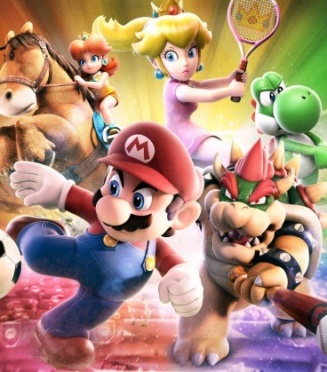
Final Inspiration
The greatest thing that happened to Cleveland is the worst thing that happened to Lebron James.
- Mahatma Mario

